Slide 1
Team Mickey Mouse

Slide 2
Jessica Teamleader
Database
Haris Spring + Maven
Barnabas Database
JAVA FX
Sébastien Database
JAVA FX
DAat

Slide 3
Golden Rules
Respect
Communication
FUN!!

Slide 4
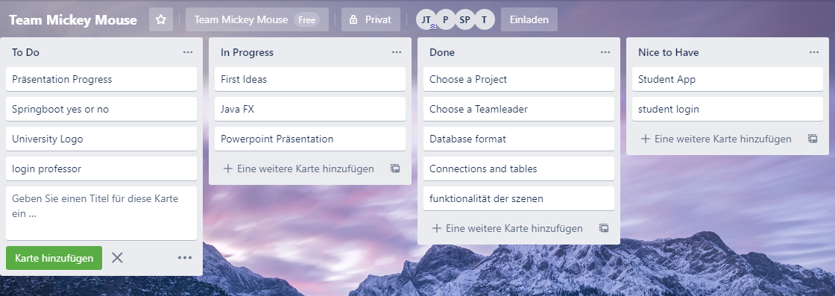
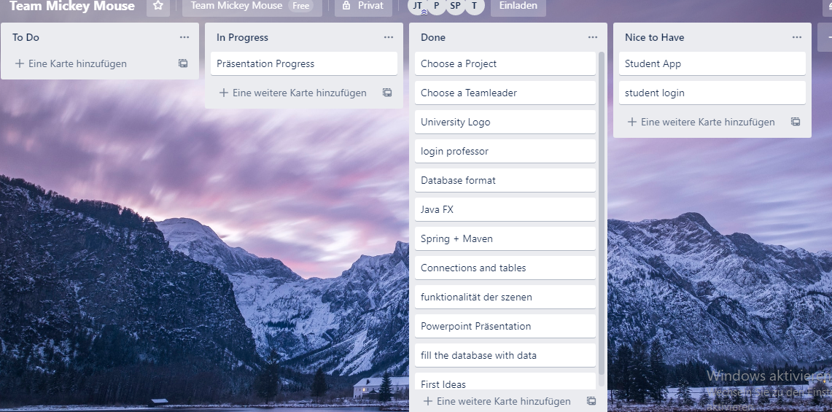
Team work
Paper and Pen
Trello

Slide 5
Timeline
Tue & Wend
Thu & Fri
Mon & Tue
Wend & Thu
-choose a Teamleader and Project
-Database Concept
-Categorized
To Do´s and Nice to Haves
-JavaFX
-Powerpoint Präsentation
-Spring
-Maven
-JavaFX
-Finished Database
format
-University Logo
-JAVA FX
-Styling
-Finished Powerpont
-some Stylings
-finished Project

Slide 6
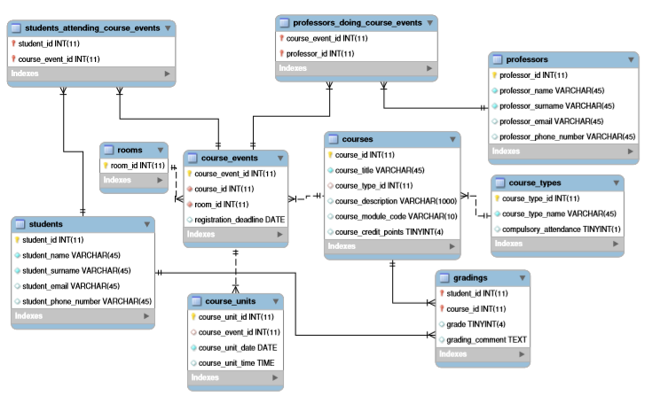
Database Diagramm

Slide 7
What we learned?
-time management
- if somebody is sick is not that big problem
-communication is key

Slide 8
What would we do if we had more time?
more data for Database
improve Styling and functionallity

Slide 9
Do you have any questions?

Slide 10
Thank you for your attention!

